Slide 1
UofT Engineering Finance Association
Finance 101
Financial Accounting
Garrett Kuhlmann – Co-President
Ashton Wu – Co-President

Slide 2
Intro to Accounting
UTEFA
Three main types of accounting:
Financial, managerial, tax
Financial Accounting: how financial information of a business is recorded and classified
GAAP(Generally Accepted Accounting Principles): standards and conventions that accountants follow
Introduction
Balance Sheet
Income Statement
Cash Flow
Conclusion
Notes:
2

Slide 3
Balance Sheet
UTEFA
Presents the financial position of a firm at a particular moment in time
Three main sections: assets, liabilities, and equity
Assets: economic resources with the ability or potential to benefit the firm
Liabilities: creditors’ claims on the assets of the firm
Equity: owner’s claim on the assets of the firm
Assets = Liabilities + Equity
Introduction
Balance Sheet
Income Statement
Cash Flow
Conclusion
Notes:
3

Slide 4
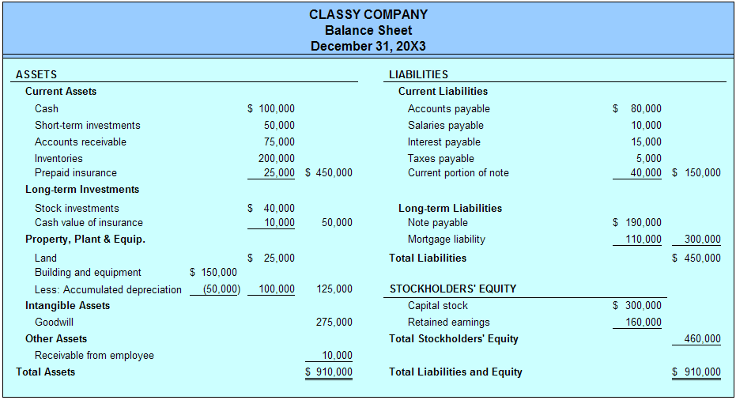
Balance Sheet
UTEFA
Introduction
Balance Sheet
Income Statement
Cash Flow
Conclusion
Notes:
4

Slide 5
Assets
UTEFA
Two main categories: current and non-current
Current assets are reasonably liquid
Examples: cash, short-term investments, accounts receivables, inventory, prepaid costs
Non-current assets are long-term assets
Examples: long-term investments, property plant & equipment (PP&E), patents, trademarks, franchises, goodwill
Introduction
Balance Sheet
Income Statement
Cash Flow
Conclusion
Notes:
5

Slide 6
Assets
UTEFA
Introduction
Balance Sheet
Income Statement
Cash Flow
Conclusion
Notes:
6

Slide 7
Liabilities
UTEFA
Two main categories: current and non-current
Current liabilities are obligations that a firm is expected to pay within a year
Examples: current portion of long-term debt, accounts payable, salaries payable, taxes payable
Non-current liabilities are long-term debt obligations
Examples: bonds, long-term debt obligations
Introduction
Balance Sheet
Income Statement
Cash Flow
Conclusion
Notes:
7

Slide 8
Liabilities
UTEFA
Introduction
Balance Sheet
Income Statement
Cash Flow
Conclusion
Notes:
8

Slide 9
Shareholders’ Equity
UTEFA
Two main types: Contributed Capital and Retained Earnings
Contributed Capital: Funds invested by shareholders for an ownership stake in the company
Retained Earnings: Earnings which the firm has retained since its formation. RE = RE_{prev} + Net Income
Introduction
Balance Sheet
Income Statement
Cash Flow
Conclusion
Notes:
9

Slide 10
Shareholders’ Equity
UTEFA
Introduction
Balance Sheet
Income Statement
Cash Flow
Conclusion
Notes:
10

Slide 11
Income Statement
UTEFA
The income statement presents the results of the operating activities of a firm for a specific period of time (i.e. one year, one quarter, etc.)
Net Income = Total Revenues – Total Expenses
“Bottom Line”
“Top Line”
“Costs”
Introduction
Balance Sheet
Income Statement
Cash Flow
Conclusion
Notes:
11

Slide 12
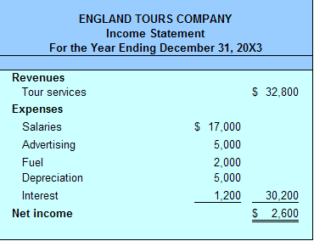
Income Statement
UTEFA
Earnings Before Interest, Taxes, Depreciation, Amortization (EBITDA)
Earnings Before Interest, Taxes (EBIT)
Dividends are displayed below NI if applicable
Introduction
Balance Sheet
Income Statement
Cash Flow
Conclusion
Notes:
12

Slide 13
Statement of Cash Flows
UTEFA
Reports the net cash flows relating to operating, investing and financing activities
The cash flow statement is very important to understand the operations of the company
Cash at End | = | Cash at Beginning + Cash from Operations + Cash from Investing Activities + Cash from Financing Activities
Introduction
Balance Sheet
Income Statement
Cash Flow
Conclusion
Notes:
13

Slide 14
Statement of Cash Flows
UTEFA
OCF: the amount of actual cash made by a company’s business operations
CFF: accounts for external activities including issuing dividends, adding or changing loans, or issuing and selling more stock
CFI: change in a company’s cash from gain or losses in financial markets
Introduction
Balance Sheet
Income Statement
Cash Flow
Conclusion
Notes:
14

Slide 15
Statement of Cash Flows
UTEFA
Cash flow statements can be derived from the balance sheet
An increase in assets on the balance sheet must result in a decrease in cash on the cash flow statement
An increase in liabilities or shareholder’s equity must result in an increase on the cash flow statement
Introduction
Balance Sheet
Income Statement
Cash Flow
Conclusion
Notes:
15

Slide 16
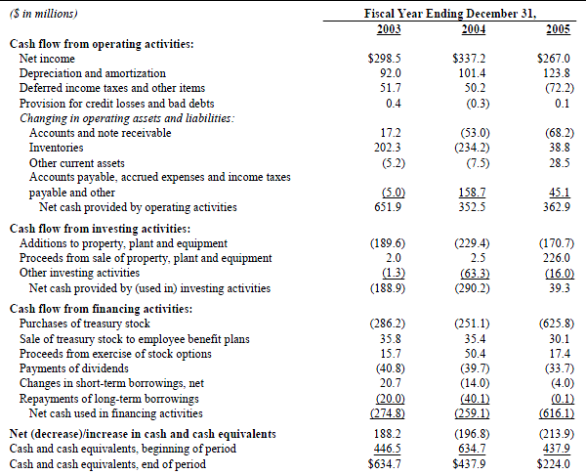
Statement of Cash Flows
UTEFA
Introduction
Balance Sheet
Income Statement
Cash Flow
Conclusion
Notes:
16

Slide 17

Questions or Comments?
Notes:
17

